Slide 1
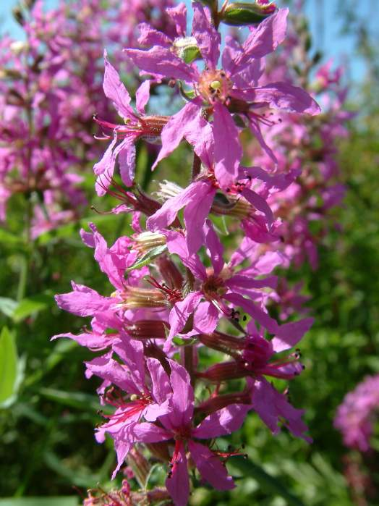
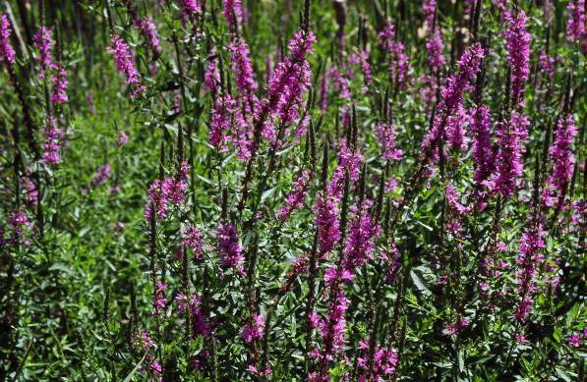
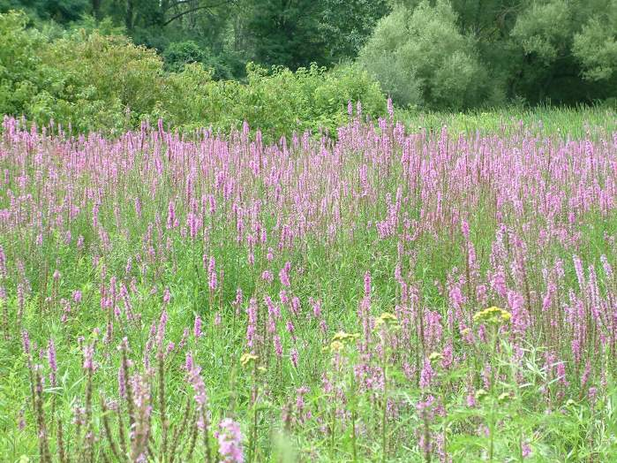
Purple loosestrife is easy to identify when in blossom.
Lessoning Loosestrife

Slide 2
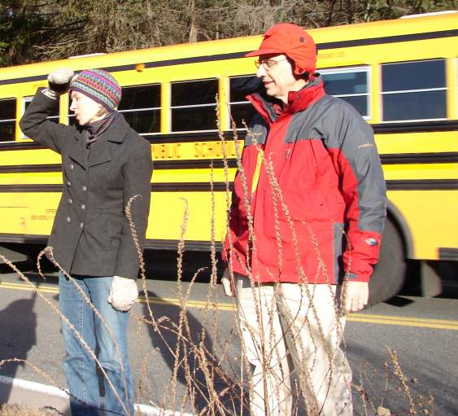
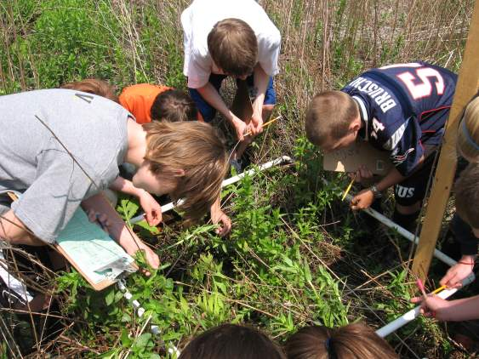
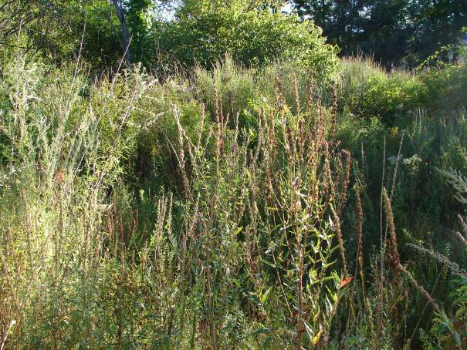
Winter
Spring
Fall
Summer
Can you identify it in other seasons?
Lessoning Loosestrife

Slide 3
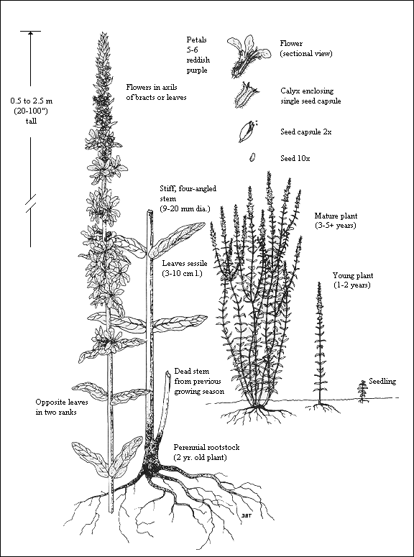
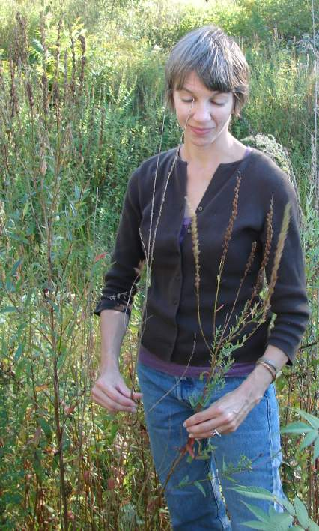
Can you identify it in other seasons? Which one is purple loosestrife?
Lessoning Loosestrife

Slide 4
Can you identify it in other seasons? Which one is purple loosestrife?
Lessoning Loosestrife

Slide 5
What part of the plant produces the seed?
Do you think Purple loosestrife grows taller every year, or dies back and grows up again?
What part of the plant continues living in the winter?
Lessoning Loosestrife

Slide 6
What part of the plant produces the seed?
The job of flowers is to produce seeds.
Does Purple loosestrife grow taller every year like a bush, or die back and grows up again from the roots ?
Dies back. Plant grows up from stored energy in roots.
What part of the plant continues living in the winter?
The roots.
Lessoning Loosestrife

Slide 7
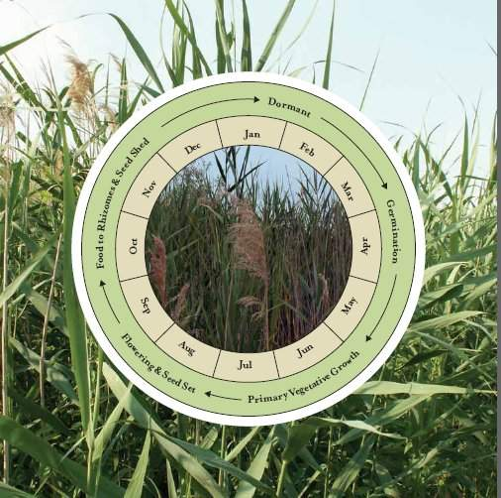
This is life cycle model for Phragmites, another invasive plant.
Challenge: Observe purple loosestrife through the year and create a life cycle timeline for purple loosestrife
Lessoning Loosestrife

Slide 8
New Growth. Seeds sprout & grow.
Spring
Winter
Old dead stalks remain
Fall: Flowers go to seed.
Summer,
Flowers bloom
Lessoning Loosestrife

Slide 9
Make a prediction: When does your purple loosestrife growing season begin and end in your town?
Read background information to help you with this. Observe to see what happens.
Mar
Apr
Feb
May
Jan
June
Dec
July
dormant
Nov
Aug
germination
Oct
Sep
vegetation growth
flowering and seed set
Food in roots and seeds shed
Lessoning Loosestrife

Slide 10
Make a prediction: When does your purple loosestrife growing season begin and end in your town?
Observe to see what happens.
Mar
Apr
Feb
May
germination
Jan
June
Dec
July
vegetation growth
dormant
Here’s a guess. Does your prediction look like this?
Nov
Aug
Oct
Sep
flowering and seed set
Food in roots and seeds shed
Lessoning Loosestrife

Slide 11
New Growth. Seeds sprout and grow.
Spring
Winter
Mar
Apr
Feb
May
Jan
June
Old dead stalks remain
Dec
July
Nov
Aug
Oct
Sep
Observe to see what really happens at your site. Take photos each season to record.
)
Summer,
Flowers bloom
Lessoning Loosestrife

Slide 12
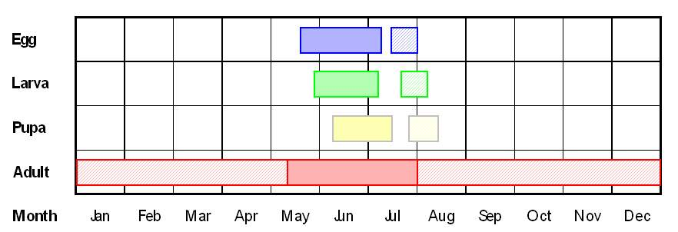
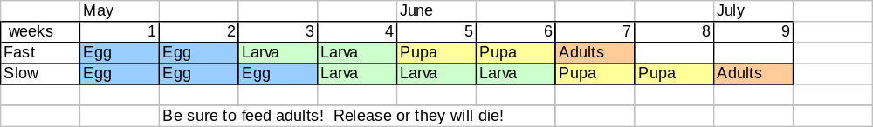
Figure 3. Lifecycle of Galerucella calmariensis and G. pusilla. Solid colored bars represent the length of activity for each of the life stages. Short patterned bars for the upper three stages represent potential second generation activity.
Lessoning Loosestrife

Slide 13
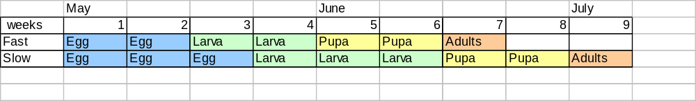
Compare the life cycle of the Galerucella beetles and the purple loosestrife. Why do you think this plant is a good match for the beetles?
Lessoning Loosestrife

